Slide 1
Trust Metric Estimator

Slide 2
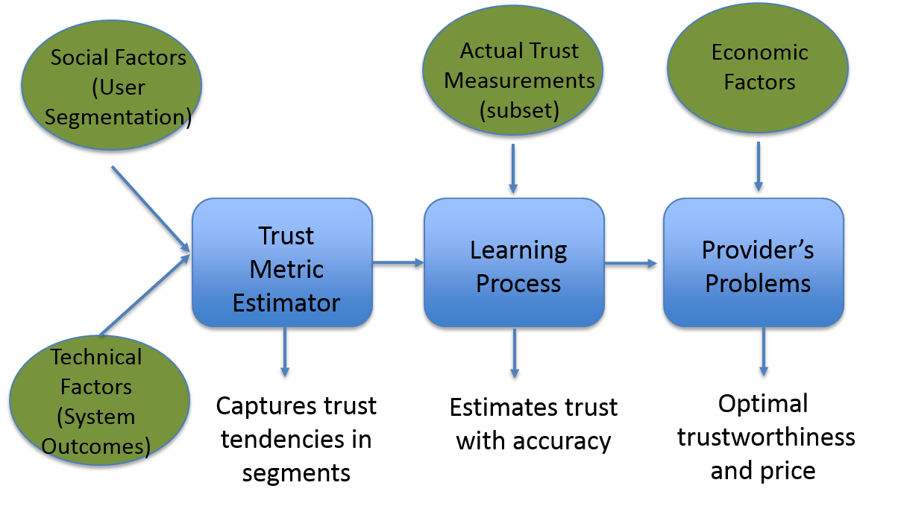
Trust Metric Estimator
Objective:
A trust computational model → estimate a user’s trust level towards the performance of a system across time → help providers make optimal decisions.
Methodology:
Identify: the impact of social and technical factors on trust.
Develop: computational model(s) for trust estimation, capturing (1).
Integrate: trust & trustworthiness level and economic factors in a single optimization problem → capture both user’s and provider’s decisions.

Slide 3
Trust level affecting decisions
Trust level : (both technical and social factors)
The subjective belief about system trustworthiness.
Users may under/over or accurately assess trustworthiness.
Trust Related Decisions: (trust-tw correlation and economic factors)
Users : To pay the price and buy the offered system (or not).
Provider: The trustworthiness and price of the offered system that maximize profits. (utilize the derived knowledge on trust)

Slide 4
Research on the impact of social factors
Two Surveys (Y1 & Y2) were conducted aiming to:
Identify the key attributes that affect the subjective nature of trust.
Validate the key attributes (comparison between surveys).
→ Support the trust computational model.
Surveys data-mining → Users Segmentation.
Three underpinning attributes: (Anova analysis)
1) trust stance, 2) seeking behavior, 3) competences.
Four segments: (K-means clustering Algorithm)
1) High Trust (HT) , 2) Highly active Trust seeking (HATS)
3) Medium active Trust seeking (MATS) , 4) Ambivalent (A)
Notes:
(1) Propensity or disposition to trust in general others: the tendency of people to trust other people across a wide range of situations and persons, composed of two constructs:
* the general faith in others or the extent to which one assumes that general others are, competent, benevolent and have integrity.
* the trust stance or the extent to which one, regardless of attributes he/she gives to people, assumes better outcomes when dealing with people as though they are reliable and well-meaning;
(2) Trust beliefs in general professionals: the extent to which one believes professionals in general are integer, competent and reliable in relation to the price of the service offered;
(3) Institution based trust: the trustor’s confidence or belief that favourable conditions are in place that are conductive to situational success
It is composed of the following two constructs:
(3a) structural assurance: the belief one has that structures such as regulations and safeguards exists that are conductive to situational success
(3b) situational normality: the belief that a properly setting exists that is conductive to situational success ;
(4) General trust sense levels in online applications and services: the general sense of trusts in online applications across different situations and domains;
(5) ICT-domain specific sense of trust levels: the extent to which trust sense levels differs between different ICT service domains;
(6) Trust related seeking behavior: the behavior someone claims to show to actively check the reputation, integrity, competence and benevolence of a provider in order to increase his or her trust in the service;
(7) Trust related competences: the extent to which someone feels he or she is competent to understand and detect potential risks.
(8) Perceived importance of trustworthiness design elements: the extent to which various design elements are perceived as important for enhancing the trustworthiness of an online application.
The goal of this data mining exercise is to uncover classes of or linkages between different sets of trustor’s attributes hence be able to segment trust related user experiences on trustor’s attributes. For this exercise, a clustering technique was used ( the K-means clustering algorithm) to segment different trust related user experiences and an Anova analysis was performed to test for each item whether statistical significance differences could be found between the uncovered trust related user experience segments.
An online survey was conducted in February-March 2013 involving an international set of participants coming from 28 countries in total with major representation of following two countries: United Kingdom (32%) and Greece (18%). Out of the survey participants, (N=) 90 respondents were eligible to be included in the segmentation analysis because they completed the whole survey.
(D2.2)
The survey data is analysed on two levels: on the one hand ‘generic’ and on the other hand ‘segment specific’. The results on the generic level are outlined in the D2.1 deliverable. These results serve to explore and provide qualitative verification of social-economic-legal areas (and measures) of concern identified in the literature. The more segmented results are discussed in the sections below and serve to provide key insights and building blocks for the modelling and estimation of user trust.

Slide 5
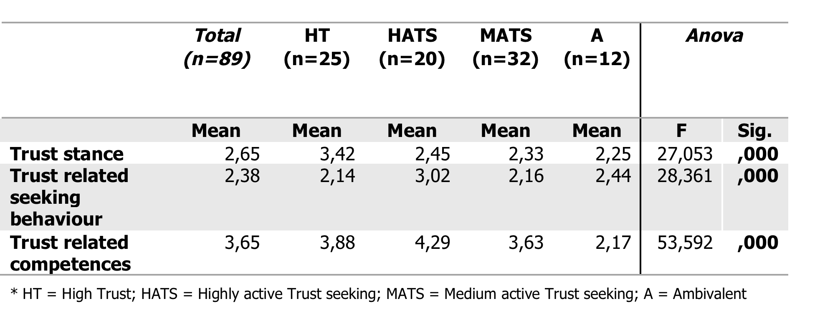
Validation of users’ Segmentation
Year 1 & 2 Results
Repeating Results
The three underpinning users’ attributes) appear with statistical significance.
Four segments were identified.
The aggregate value of competence and seeking is dominant in “HATS”.
The trust stance is dominant in “HT”.

Slide 6
Towards the Trust Computational Model
Assumptions on key user attributes and their impact:
Combined factor of competences and seeking → determines the accuracy of trustworthiness assessment.
“HATS” : Most accurate assessment of trustworthiness among all segments.
Trust stance → Determines under/over estimation.
“HT” : Trust is expected to overestimate trustworthiness.
In all segments: adequate competences and seeking to distinguish between two different systems.
Trust within the same segment is expected to be higher towards a better performing system (compared towards one with lower trustworthiness)

Slide 7
Basic Bayesian Trust Inference Model
Trust : Quantifies the subjective probability that the system will provide a successful outcome in the next single transaction.
$$τ\left(t\right)=E[Beta\left(a\left(t\right),β\left(t\right)\right]=\frac{α(t)}{α\left(t\right)+β(t)}$$
Update Process based on outcomes observed: (event driven)
After a success: $a\left(t+1\right)=a\left(t\right)+A$
After a failure : $β\left(t+1\right)=β\left(t\right)+B$
Here, A=B=1→ $trust≈trustworthiness$ as outcomes increase.

Slide 8
Modified Bayesian Inference Model
Extended the expected properties to all segments.
Followed a self-normalized approach based on the dominant drivers.
Captured the differentiations among users (social factors):
Initial trust : Initialization of Beta parameters ($α_{i,s}\text{(0)},β_{i,s}$(0) ).
Trust evolution: Different update coefficient for each segment :
$$a_{i,s}\left(t+1\right)=a_{i,s}\left(t\right)+A_{i,s} and β_{i,s}\left(t+1\right)=β_{i,s}\left(t\right)+B_{i,s}$$

